Slide 1

Resume Building 101
Alumni Mentorship Programme
July 2022

Slide 2
What is BITS Alumni Association?
The Journey continues ….
One of the largest and strongest alumni bodies in the world with 150k+ alumni
100+ chapters around the globe
Maximize the potential of BITSians & BITS-Pilani
What do we do?
Job Support Initiative
Sahaaya
Propel
BITS2MSPhD, BITS2BSchool
BITS-Spark
BITSians Day
Emergency Support
Scholarships & Awards
AMP
Podcasts and much more
Sign up at https://www.bitsaa.org/
Chairperson : Harsh Bhargava - LinkedIn
CEO : Sai Prameela Konduru - LinkedIn
COO : Neeti Pokharna - LinkedIn

Slide 3
What is BITSAA Alumni Mentorship Program?
Objective: To help students and alumni navigate, enrich and AMP-lify their lives beyond BITS
Activities for current students
Resume Building
Domain Introductions
Mock Interviews + Resume Review
Activities for graduates
Mentorship connect with senior alumni
Networking Sessions
AMP Team
(click name for LinkedIn)
Charul Bansal
Palak Oswal
Subham Thakur
Utsav Awasthi
Vaishali Soni
Vidyayani Durga
Saee Abhyankar
Balajee RS
Jay Pokarna
Manan Ahuja

Slide 4
The average time spent by recruiters looking at a resume is ...
~7 seconds

Slide 5
What makes a good resume?
Professional Experience
Tools and Techniques
Academics and Co-curriculars
Coursework, MOOCs and Certifications, Scholarships & Awards, Conferences & Workshops
Academic Projects
Extra Curriculars Activities
Positions of Responsibility and Volunteer Experience
External Awards and Scholarships
Patents and Publications
Competitions and Test Scores
Others - Languages known, Interests

Slide 6
Worried you might not have enough content for all the sections?
Well you should not!
For your ally is the Force AMP

Slide 7
What counts as a professional experience?
Internships, Full time work-ex, Own Startup (if it has customers)

Slide 8
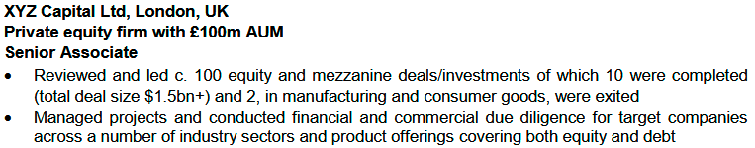
Professional Experience
QUANTIFY - Write business impact in numbers - dollar values, #users, improved efficiency in hours, %improvements, rankings, ratings etc
Write about Professional Work Experiences like internships or any start-up(s) you co-founded.
Most recent first
Write timeline against each position
One liner about the company
List all Position(s) held to show growth. Most recent first
One bullet for one project
Use PAR method - Problem, Action and Result
Keep it short and to the point
Google “verbs for <domain>”
Examples - Integrated, Consolidated, Organized, Delivered, Engineered etc.
Do NOT be vague. Use simple words and avoid jargons

Slide 9
Some tips on punctuation and highlighting important parts
Use Caps/Bold/Italic sparingly
Be consistent. For reference -
Capitalize or Bold section headers
Bold company names and impact
Italicize name of position, degree and timeline i.e. things which are less important that the Bold components
Do NOT use underline
Be consistent with periods at the end of bullets - Either end all bullets with a period or none
DO NOT go crazy on Caps/Bold/Italic

Slide 10


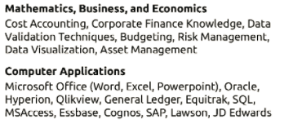
Tools and Techniques
Always have a section mentioning hard skills you know. Here are some illustrative examples -
Full-stack developer
Data Scientist/Analyst
Financial Analyst
Mechanical Engineer
Try to have this section at the top. Current students can fill this under ‘Subjects’ section in Superset portal

Slide 11
Can you write about Coursera/Udemy courses in your resume?
YES!

Slide 12
Academics
Current students will need to fill details on Xth, XIIth and College in the portal. Once you have work-ex you can skip writing about Xth and XIIth and possibly skip CGPA too e.g
Mention relevant coursework
(Under ‘Subjects’ section on Superset)
Mention if you attended any relevant conferences and workshops
Write bullets on Merit Scholarships received, if any. Same for any awards on academic achievements like Gold medalist
Feel free to mention relevant MOOCs you have completed with certification in the similar format

Slide 13
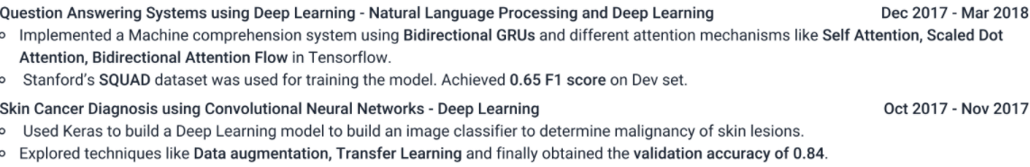
Academic Projects
While writing about Academic projects, you need to follow almost similar guidelines as you do while writing about work ex
Write relevant Projects undertaken e.g. For a SDE role,
OKAY -“Designed front-end of Oasis ‘20 website”
NOT OKAY - “Built a central opening bridge model”
Unless you need it as a filler
Concise meaningful titles with domain
Write timeline against each project. Sort by relevance and then recency
Bold the parts you want the recruiter to notice i.e, the keywords in the line
QUANTIFY - Write impact in numbers - dollar values, #users, express efficiency in hours, %improvements, rankings, ratings
Try to mention skills, tools and techniques used. Bots shortlist resume by keywords

Slide 14
Should you mention hobbies on our resume? JEE/GMAT score?
It depends!

Slide 15
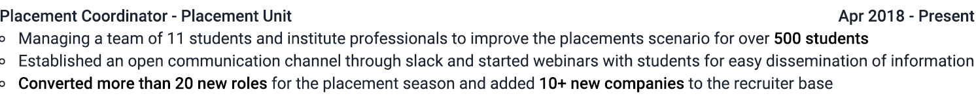
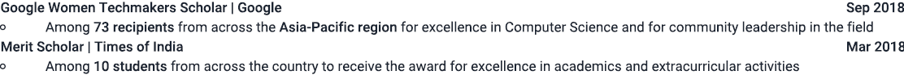
Extra Curriculars
Position of Responsibility & Volunteer Experience - Largely Similar to how you write work experience
Timeline
Arrangement - Chronological/
Importance
Mention your role at organization briefly. Use action verbs - Spearheaded, converted, established
You can bold the phrases where necessary
One liner about the organization (optional)
Avoid having too much whitespace, and don’t have way too much text either
Quantify your work, outcome and impact generated as much possible
Remember: PAR
External Scholarships and Grants
Mention the scale: # of people competing for the scholarship
Write about the scholarships received by universities, government, organizations.
Mention the reason for securing the scholarship

Slide 16
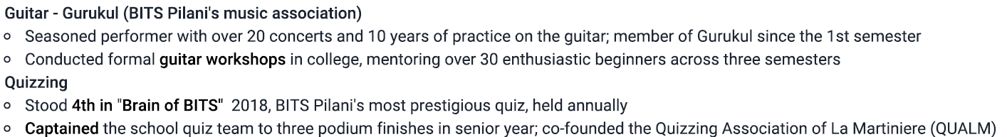
Extra Curriculars
Test Scores
Mention rank/percentile and #number of applicants
Mention score where there’s no rank (ONLY WHERE THIS ADDS VALUE & doesn’t lessen your chances)
Miscellaneous - Interests and Languages known
Mention accomplishment oriented activities
Quantify achievements;
Show your growth; new initiatives you have brought forth
Mention interests which highlight your unique personality e.g. Marathon runner, Columnist, Blogger etc

Slide 17
DOs
Choose Appropriate fonts e.g. Arial or Calibri or Garamond
Size 12
Make sure your contact details are updated
Be consistent with periods at the end of sentences
Add LinkedIn, GitHub and (relevant) personal blog links
Save and share resume in PDF format only
Use industry specific keywords. You will find them in Job Descriptions
Use a professional sounding PERSONAL email
e.g. strictly avoid
cooldude2000@gmail.com
Get someone to proofread your resume. Repeat with 2 more people
Check for Grammatical and spelling mistakes
‘Justify’ each line. All document editors have this option
Emphasize Achievements, not responsibilities. Stress Leadership experience
Store your resume in Cloud. Gmail will work fine
Add relevant MOOCs
Save your resume PDF with a proper filename

Slide 18
DON’Ts
Don’t Write “References Available Upon Request”
Don’t write declarations at the end of resume.
Don’t write Marital status
Don’t overuse Bold, Italics and Caps extensively
Avoid keeping an ‘Objective’ section unless you are looking for a specific role Instead write one liner on your work experience
Don’t have too many trailing whitespaces in lines
Avoid colorful fonts in general
Don’t add generic hobbies like reading or playing cricket
Don’t go beyond 0.5” for bottom and top margins and 0.75” for side margins
Don’t lie about anything!

Slide 19
For interviews, your resume is the syllabus
Memorize it like the back of your hand!
Notes:
Expect to be questioned on any points mentioned in the resume
Better to write down some questions you anticipate and think of the answers.
Get your resume reviewed with your friends and ask them to question you on the points mentioned in your resume
Everyone exaggerates but don’t outright lie. It is hard to fool interviewers.

Slide 20
Here are some awesome resumes of BITSians for your reference
ANALYTICS
McKinsey BA McKinsey BA 2
CONSULTANCY
SOFTWARE
SDE Google SDE
CORE ENGG.
Chemical Core Electronics Core
FINANCE
OPERATIONS
MARKETING
NGO
MBA/MS/PhD
OTHERS
Non Tech
PRODUCT MANAGER
SALES
We encourage BITSians who have been placed in good companies to EMAIL US YOUR RESUME
to feature them on this page, so that your peers and juniors can benefit from them

Slide 21





Thank You!
@bitsaa_intl
BITSAA
International
The BITSAA Podcast
@bitsaaintl
CLICK TO JOIN US
@BITSAA
Created with ❤️ by BITSians
Email us with your suggestions || BITSAA - contact@bitsaa.org || AMP - amp-team@bitsaa.org

